Slide 1

AI Developer Productivity Analysis

Slide 2
Analyze the effect of sleep duration on developer performance
Objectives
Analyzed developer habits: AI usage, sleep, distractions, task success
Understand how AI usage hours impact task success
Analyze the effect of sleep duration on developer performance
Examine how coding hours relate to task completion success

Slide 3
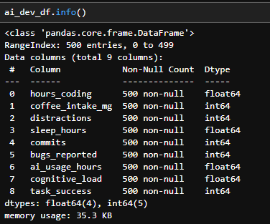
DataFrame Exploration
Observation : 500
Features:9
No missing values
Used .info(), .describe(), .isnull().sum()
Tools Used:
pandas, matplotlib, seaborn
Python environment (Jupyter Notebook)

Slide 4
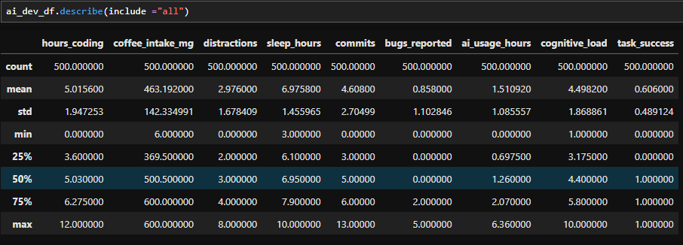
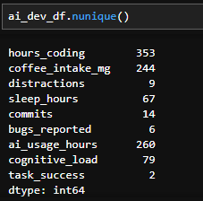
Data Overview and Missing Value Check
Basic Statistics :.describe(include="all")
Missing Values: .isnull().sum()—to check no null value

Slide 5
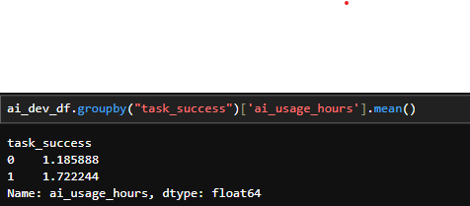
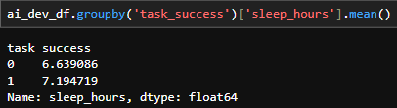
Key Insights & Grouped Analysis
AI usage vs Task Success
Sleep Hours
Successful developers tend to use AI more on average.
Task success is correlated with better sleep patterns.

Slide 6
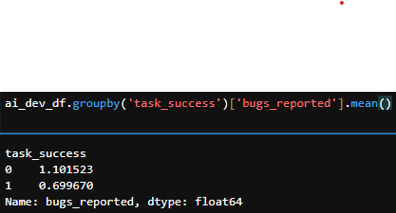
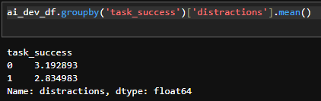
Coding Hours
BugReportd
More hours spent coding generally
align with higher task success.
I observed that failed tasks had a higher average number of bugs reported compared to successful ones
Distractions
I data shows that unsuccessful tasks are associated with a higher average number of distractions.

Slide 7
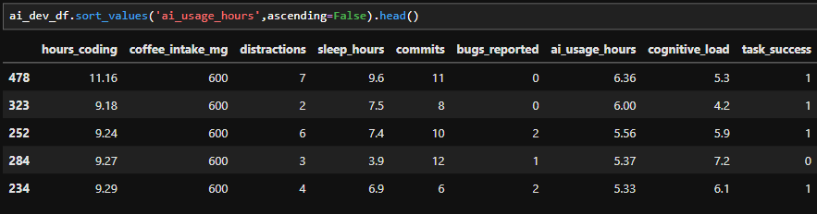
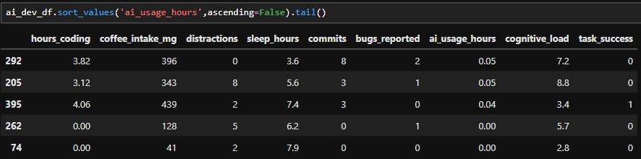
AI Tool Usage
Top 5 AI_Tools_Users
Top 5 AI_Tools_Users
Top AI users can be further analyzed for patterns (like higher success )
Developers who used AI tools more frequently had a higher average number of commits, indicating a positive correlation between AI integration and productivity.

Slide 8
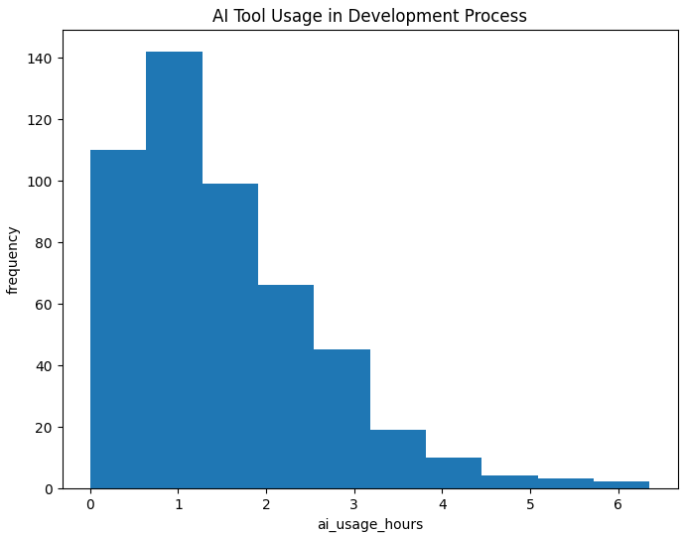
Understanding AI Adoption in Daily Development
Histogram: AI Tool Usage by Developers
A histogram is the best choice when you want to visualize the frequency distribution of continuous numeric data — like ai_usage_hours.
Visualization how many developers spend X hours using AI tools
Insight
Most developers use AI tools for 0 to 2 hours per day
Low AI usage is less common — indicating strong adoption
A small number of developers don’t use AI at all, which may affect their productivity or task success.
A few developers might be using AI for 6+ hours, which could be task-dependent or indicate over-reliance.

Slide 9
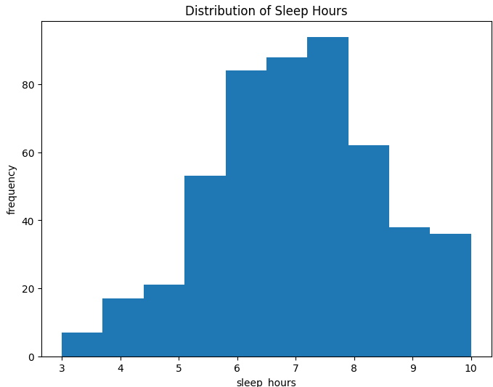
Are Developers Getting Healthy Sleep?
Visualization helps identify how many developers sleep within certain hour ranges (e.g., 5–6 hours, 7–8 hours, etc.), making it easier to spot common sleep patterns, outliers, and overall sleep behavior across the team – like sleep_hours
High variation in sleep hours suggests differing work-life balance or stress levels.
Majority of developers sleep between 6 to 8 hours, which aligns with a typical healthy routine.
Very few sleep less than 5 hours or more than 9 hours
Adequate sleep is likely linked to better performance
outcomes

Slide 10
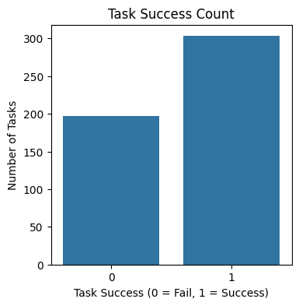
Creates a bar chart showing the count (frequency) of each category in the task_success column.
Task Success Rate – Count of Successful vs Failed Tasks
Countplot is used to visualize the frequency of categorical data – It shows how often each category appears.
It is ideal for discrete Data like – task_success,distracrtion,or any yes/no,0/1,or category-type columns
It helps identify imbalances in the dataset
Insights
This visualization gives a clear overview of performance outcomes and sets the foundation for deeper analysis
Majority of tasks are successful, indicating good productivity and workflow among developers.
The failure rate is non-negligible, which means there’s room for improvement — potentially in factors like sleep, distractions, or AI usage.

Slide 11
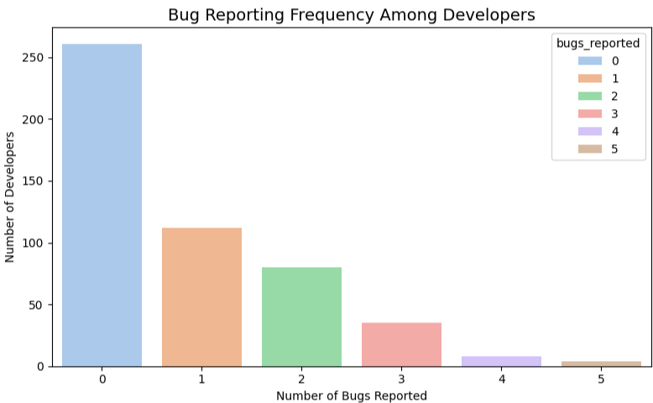
How Often Do Developers Report Bugs
Insights from bugs_reported CountPlot:
Majority of developers reported 0 or 1 bug, indicating overall stable development.
A small number of developers reported multiple bugs, which may point to skill gaps, lack of testing, or high workloads.
You can correlate high bug reporters with low sleep or high distractions to explore possible causes.
Understanding bug reporting trends helps in identifying quality control issues.

Slide 12
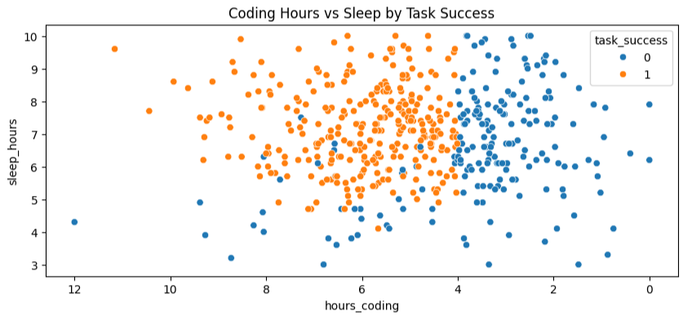
How Sleep Affects Coding Efficiency and Task Success?
Scatter Plot: Coding Hours vs Sleep hours by Task Success
Visualizes the relationship between coding hours and sleep hours per developer.
task success (0 = Fail, 1 = Success)
Helps identify patterns or clusters based on performance outcomes.
Insights
Developers with low sleep and high coding hours (top- left) showed more task failures
Balanced coding and sleep may lead to higher task success.
Successful tasks cluster around balanced sleep and coding hours

Slide 13
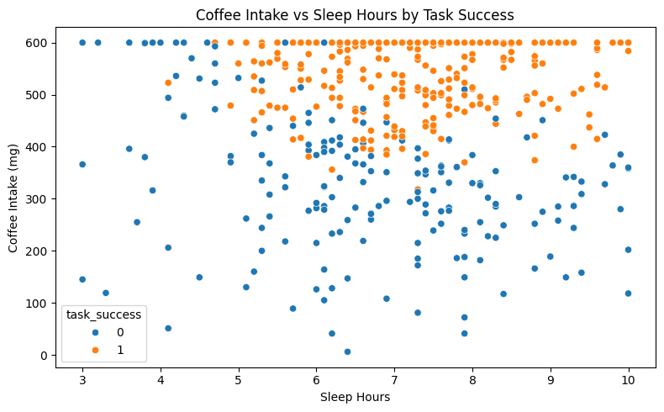
Sleep vs Coffee: Impact on Developer Task Performance
A ScatterPlot id ideal for visualizing between two continuous numerical variables
(like sleep hours and coffee intake)
By using hue =“task_success”, we can also compare how these relationships vary across Successful and failed task.
(0 = Fail, 1 = Success)
Insights
Developers who sleep less tend to consume more coffee
and Less sleep often leads to higher caffeine intake
Success is more common with balanced sleep and moderate caffeine
Excessive caffeine might reflect fatigue and reduced effectiveness

Slide 14
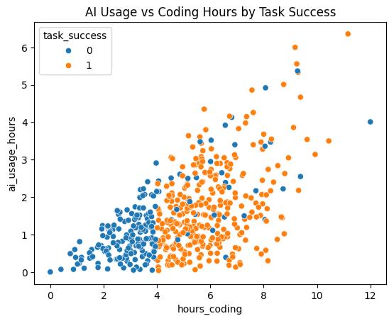
AI Usage vs Coding Hours: A Task Success Perspective
Comparing two continuous numerical features:
hours_coding and ai_usage_hours
AI usage is moderate to high(task_success =1) and
(task_success =0)AI usage is low or zero.
Successful tasks often involve moderate to high AI assistance that smart use of AI tools boosts productivity and outcomes
This plot shows a strong positive relationship between coding time and AI usage.
when developers use AI tools effectively. This suggests that AI doesn't just reduce effort.it actually improves task outcomes

Slide 15
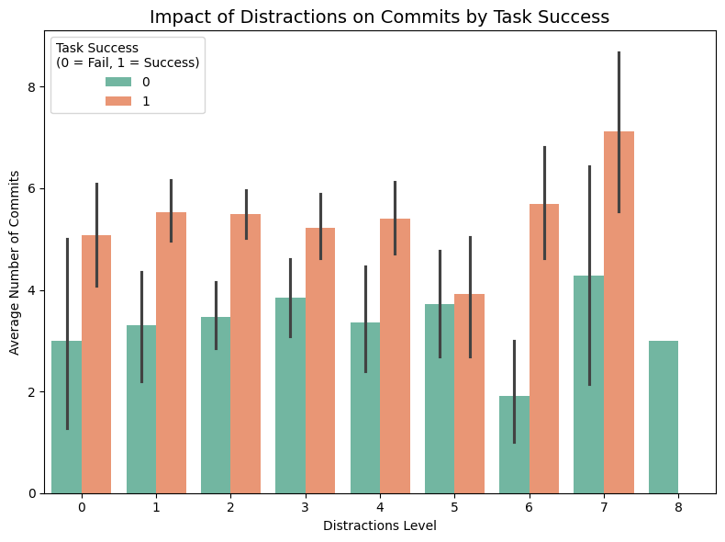
Impact of Distractions on Commits: Success vs Failure
A Bar plot is perfect for comparing average values across categories.
x=distraction(categorical),y=commits(numeric)
It allows you to see how commit behavior changes with different distraction levels.
Insight:
Lower distractions are associated with higher average commit counts, especially in successful tasks
A distractions increase, the number of commits generally decreases, indicating reduced productivity.
Successful developers tend to maintain higher commit rates even under moderate distractions.

Slide 16
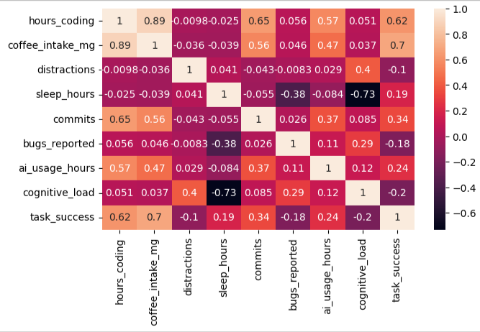
Correlation Between Developer Productivity Factors
A heatmap is ideal for visualizing pairwise correlations between numerical variables.
Strong Positive Correlation
hours_coding and commits: Developers who spend more time coding tend to make more commits.
2. Moderate Positive Correlation
ai_usage_hours and task_success: Indicates that using AI tools is somewhat associated with successful task completion.
3. Weak or No Correlation: sleep_hours has a low correlation with most other features
4 .Negative Correlation: If distraction is negatively correlated with commits or task success.it shows that more distraction lead to less productivity.
5.Diagonal Values Are Always 1:These represent perfect self-correlation and are not used for insights.

Slide 17
Conclusion
Balanced sleep is strongly linked with task success
AI usage has a positive impact on productivity and successful task completion
Distractions (like notification or multitasking) increase coding hours but reduce success
High coffee intake and long coding hours often lead to more failures
The correlation heatmap confirms that healthy work habits and tech usage together improve outcomes
"It’s not just how long developers work, but how smartly and healthily they work. Tools like AI, sufficient rest, and reduced distractions play a bigger role in productivity than raw effort alone."

